Slide 1


VIVEKANANDA INSTITUE OF TECHNOLOGY (Affiliated to VTU and approved by AICTE) Gudimavu, Kumbalagodu post, Kengeri, off Mysore road Bengaluru-560074
DEPARTMENT OF CIVIL ENGINEERING
A Presentation
On
“EXPERIMENTAL STUDY ON PARTIAL REPLACEMENT OF FINE AGGREGATE USING WASTE BRICK POWDER”
Presented By:
MAHADEV PRASAD N M ( 1VK18CV008 )
NANDISH U ( 1VK19CV403 )
NITHIN M ( 1VK19CV404 )
VINAY M SAWANT ( 1VK19CV403 )
VIII Sem
Department of Civil Engineering, VKIT
Guided By:
Dr. SHASHI KUMAR C S
Associate Professor & Head
Dept. of Civil Engineering
VKIT, Bengaluru

Slide 2
CONTENTS
ABSTRACT
INTRODUCTION
LITERATURE
MATERIALS & METHODOLOGY
TESTS
RESULTS & CONCULUSION
SHEDULE OF LABORATORY WORKS
REFERENCES

Slide 3
INTRODUCTION
Civil engineering is a professional engineering discipline that deals with the design, construction, and maintenance of the physical and naturally built environment, including public works such as roads, bridges, canals, dams, airports, sewerage systems, pipelines, structural components of buildings, and railways.
About 3 billion tones demolition waste is generated annually over the globe and 14.5 million tones in India.
Nowadays, this waste constitutes serious socio-economic and environmental problems. Through its transportation and treatment process, construction and demolition wastes (CDW) are harmful to the environment due to the greenhouse gas emissions and demolition waste disposal are difficult to manage.
Waste brick can be recycled and reused as aggregates.

Slide 4
WASTE BRICK POWDER
Bricks are widely used construction and building material around the world. Bricks have been major construction and building material for a long time.
Brick powder is obtained from the dust of disintegrated bricks also the waste bricks are obtained from garbage of a broken building. The collected waste bricks are pulverized to get the particle passing through 4.75-micron sieve to get the grading of fine aggregate for 15%, 25%, and 30% of brick powder is used as partial replacement for fine aggregate in the experiments.
Bricks waste may come from two sources: The first source is the bricks industry, and this waste is classified as non-hazardous industrial waste, the second source of bricks waste is associated with construction and demolition activity.
Therefore the replacement of fine aggregate by bricks wastes has the advantage of solving several environmental problems.

Slide 5
SCOPE OF THIS STUDY
To collect waste brick and to reuse as a partial replacement of fine aggregate.
To use waste brick powder as a construction material.
It will slightly reduce the dependency on natural sand or M sand.
Its use will also help in protecting the environment surroundings.

Slide 6
OBJECTIVES
The main objectives of present study are:
To study the suitability of waste brick powder in concrete.
To study the desirable properties of waste brick powder in concrete.
To evaluate the utility of crushed brick as a partial replacement of sand in concrete.
To understand the effectiveness of brick as in strength enhancement.

Slide 7
MATERIALS & METHODOLOGY
Cement : Ordinary Portland cement of grade 53.
Fine aggregate : Fine aggregate passing 4.75mm IS sieve.
Coarse aggregate : Segregated aggregates retaining 4.75mm IS sieve and passing 20mm IS sieve.
Waste brick powder : passing 4.75mm IS sieve.
Water : Required amount of water by trial.
MIX PROPORTON OF CONCRETE
The mix proportion is designed for M25 concrete conforming IS codes.

Slide 8
Concrete Mix Design for M – 25 Grade of Concrete
Step-1 STIPULATION FOR PROPORTIONING
Grade= M25
Type of cement= 53 grade
Max. size of aggregate= 20mm
Min. cement content and max. water cement ratio= IS456 table9
Workability= 50mm
Method of placing = pump able
Type of aggregate= crushed angular
Fine aggregate= zone 2
Step-2 TEST DATA
Specific gravity of cement= 3.25
Specific gravity of coarse aggregate= 2.55
Specific gravity of fine aggregate= 2.53
Water absorption= 0.15%-2.2%
Specific gravity of water = 1

Slide 9
Step-3 TARGET STRENGTH
f’ck= fck+1.65(s) s=4
31.6N/mm²
workability means slump value more than 50 mm, the required water content may be increased or decreased by about 3 percent for each increase or decrease of 25 mm slump or may be established by trial.
We have a nominal maximum size of aggregate of 20 mm.
the water content for the nominal maximum size of aggregate is 186 kg (Liter). (Slump 50 mm)
We want to increase the slump up to 100 mm. so we have to increase it twice by 25 mm. As per IS code we have increase water by about 3 percent for every additional 25 mm slump so here estimated water content for 100 mm slump.
For one 25 mm (3%) and second 25 mm (3%). Total increase in water content is 6%
= 186 + 186x(6/100)
= 197.16 Liters
Step-5 Estimation of Cement Content
We have water content and water–cement ratio. So, from this data, we can calculate cement content for concrete,

Slide 10
Water-Cement Ratio = 0.62
Water / Cement = 0.62
197.16 / Cement = 0.62
Cement = 197.16/0.62
Cement = 318 Kg.

Slide 11
QUNATITY OF MATERIAL REQUIRED
CUBE DIMENSION: 150X150mm
OPC cement grade 53 = 64.8 kg.
Fine aggregate = 44.554 kg.
Coarse aggregate = 108 kg.
Waste brick powder = 9.456 kg.

Slide 12
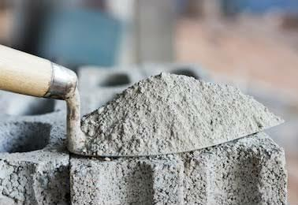
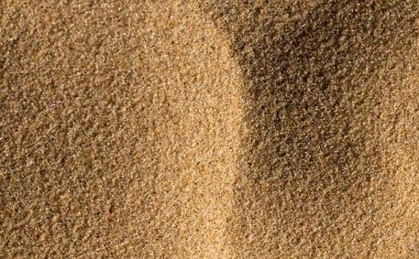
TESTS ON MATERIALS.
CEMENT
Normal consistency.
Specific gravity.
FINE AGGREGATE
Fineness modulus and zoning.
Specific gravity.
Bulk density of fine aggregate

Slide 13
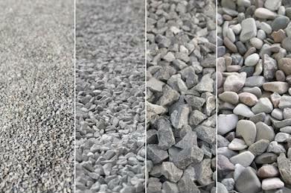
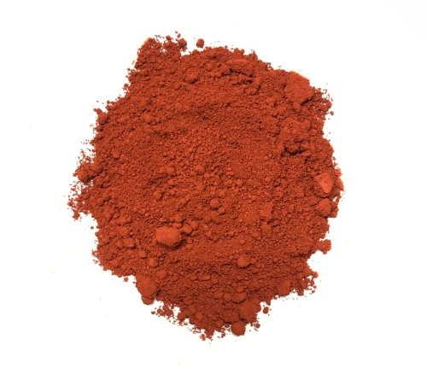
COARSE AGGREGATE
Fineness modulus and grading.
Specific gravity.
Impact test.
Flakiness & Elongation
BRICK POWDER
Fineness modulus and zoning.
Specific gravity

Slide 14
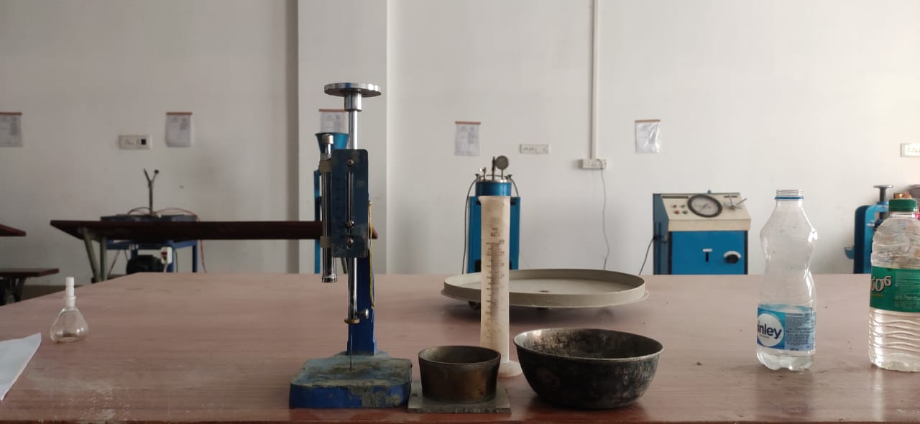
TESTS ON CEMENT
Normal consistency of cement
Weight of cement = 300gm
Trial | Water (%) | Water (ml) | Initial reading (mm) | Final reading (mm) | Percentage of Plunger
01 | 27 | 100 | 41 | 38 | 4
02 | 29 | 104 | 41 | 36 | 5
03 | 30 | 112 | 41 | 16 | 15
04 | 31 | 116 | 41 | 12 | 19
05 | 32 | 120 | 41 | 06 | 32
Penetration= 32%

Slide 15
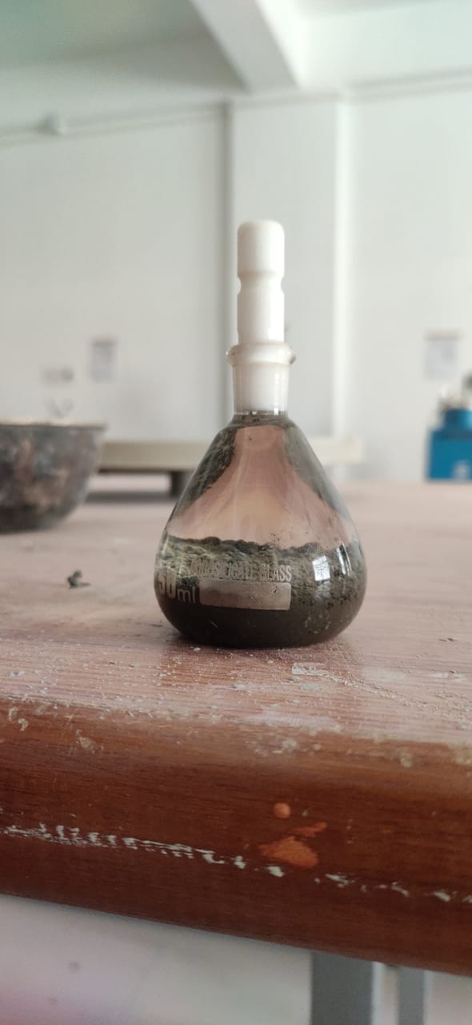
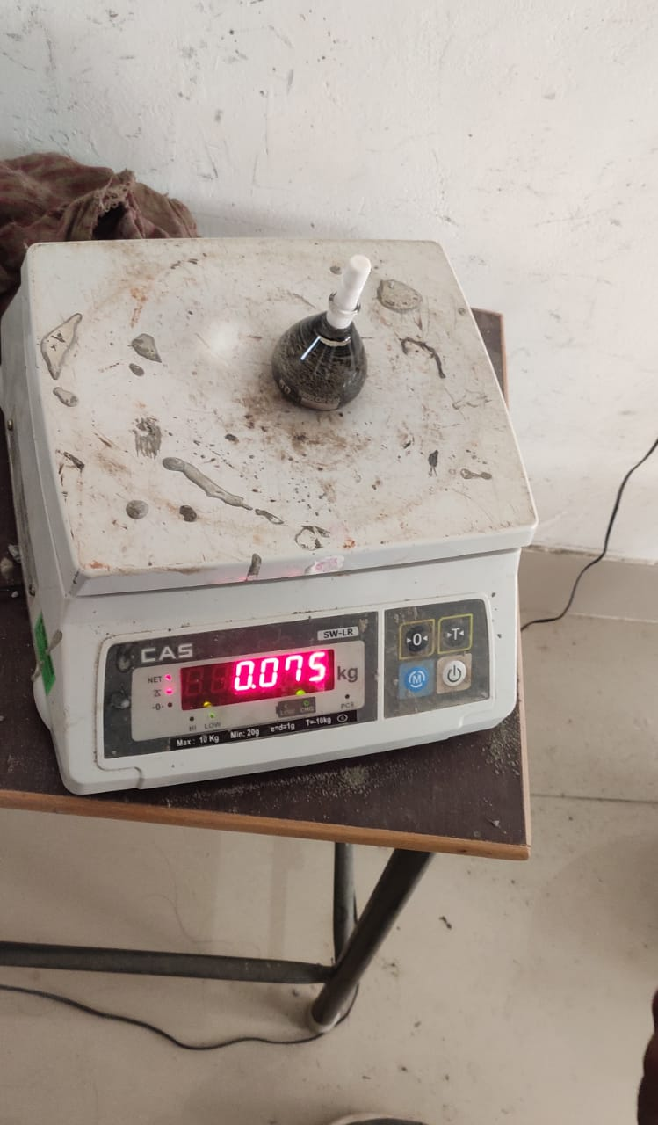
Specific gravity of cement.
Density bottle method
Wt. of cement taken W = gm.
Specific gravity = W2-W1/(W2-W1)-(W3-W4)
Specific gravity of cement = 3.16
Sl no | Empty weight of density bottle (W1) | Weight of bottle + cement (W2) | Weight of bottle + cement+ kerosene (W3) | Weight of bottle + kerosene (W4)
01 | 25 | 44 | 75 | 61

Slide 16
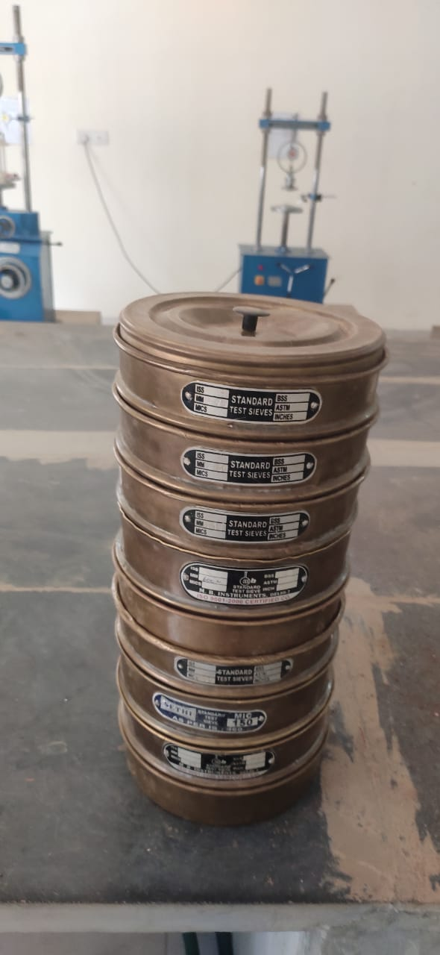
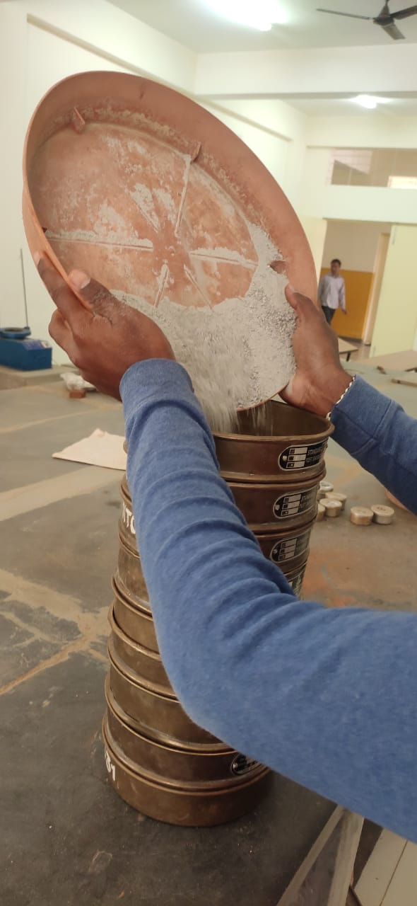
TESTS ON FINE AGGREGATE
Fineness modulus of fine aggregate.
Weight of aggregate = 1 kg
Sl no | IS Sieve(mm,µ) | Weight Retained(g m) | Cumulative Weight Retained(gm) | Cumulative Retained(%) | Cumulative Passing(%)
1 | 4.75 | 0 | 0 | 0 | 100
2 | 2.36 | 75 | 7.5 | 7.5 | 92.5
3 | 1.18 | 227 | 22.7 | 30.2 | 69.8
4 | 600 | 172 | 17.2 | 47.4 | 52.6
5 | 425 | 154 | 15.4 | 62.8 | 37.2
6 | 300 | 30 | 3 | 65.8 | 34.2
7 | 150 | 215 | 21.5 | 87.3 | 12.7
8 | 75 | 102 | 10.2 | 97.5 | 2.5
9 | Pan | 25 | 2.5 | 100 | 0
Fineness modulus ∑ = (cum retained%) / 100
Fineness modules of fine aggregate = 2.75

Slide 17
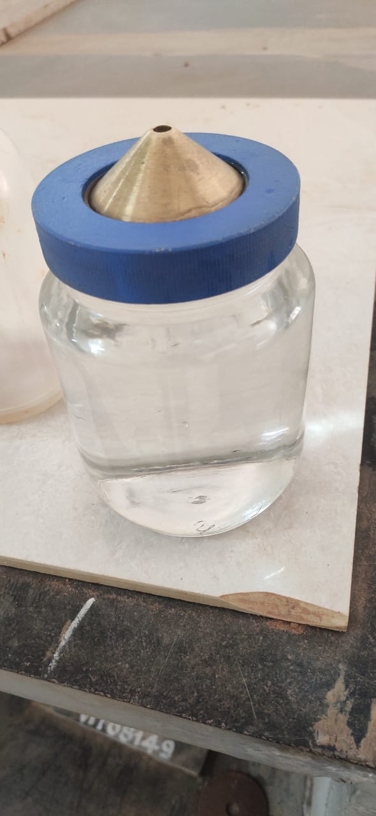
Specific gravity test on fine aggregate.
Spefic gravity of fine aggregate= W2-W1
Sl no | Weight (gm) | Trial 1 | Trial 2 | Trial 3
1 | Weight of empty Pycnometer(W1) | 661 | 661 | 661
2 | Weight of empty Pycnometer + FA (W2) | 1066 | 1075 | 1062
3 | Weight of empty Pycnometer + FA + water (W3) | 1785 | 1797 | 1790
4 | Weight of empty Pycnometer + water (W4) | 1540 | 1540 | 1540
5 | Specific gravity | 2.53 | 2.63 | 2.65
= 2.60
(W2-W1) – (W3-W4)

Slide 18
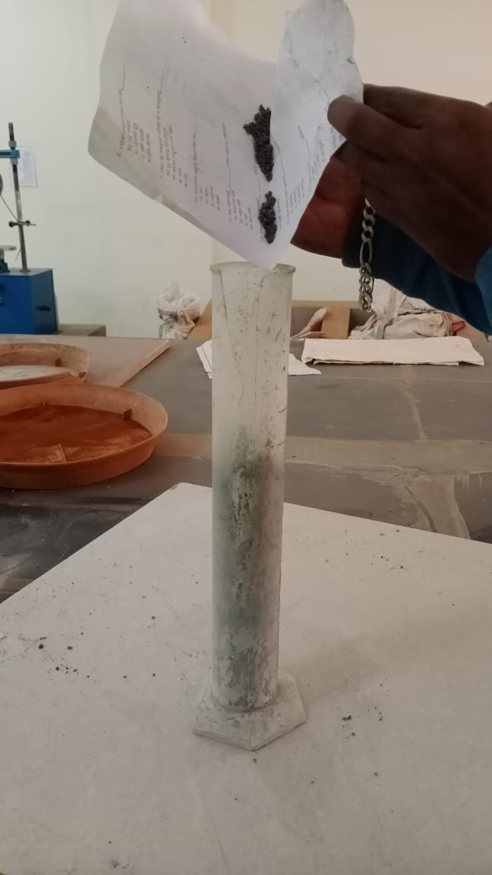
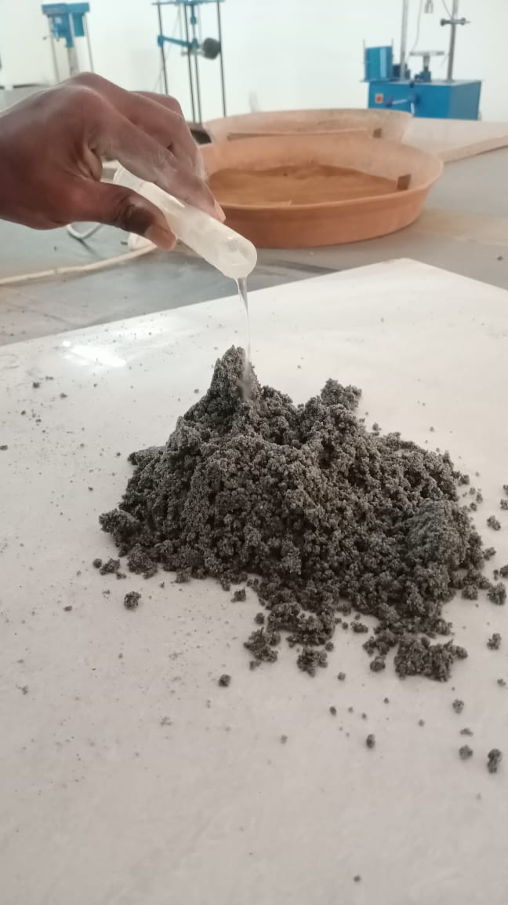
Bulking of fine aggregate.
Weight of fine aggregate= 501gm
Initial height of sand H1= 300mm
Maximum bulking of fine aggregate= 46%
Sl no | % of water | Volume of water in ml | Height of sand | Page bulking H2-H1
*100
H1
1 | 2 | 10 | 375 | 25
2 | 2 | 10 | 390 | 30
3 | 2 | 10 | 410 | 36
4 | 2 | 10 | 440 | 46
5 | 2 | 10 | 390 | 30
6 | 2 | 10 | 345 | 15

Slide 19
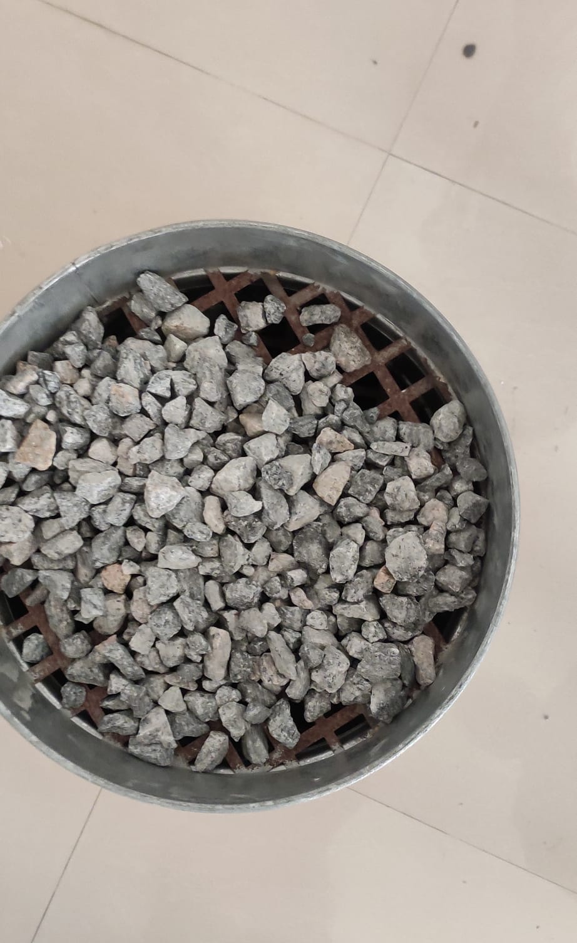
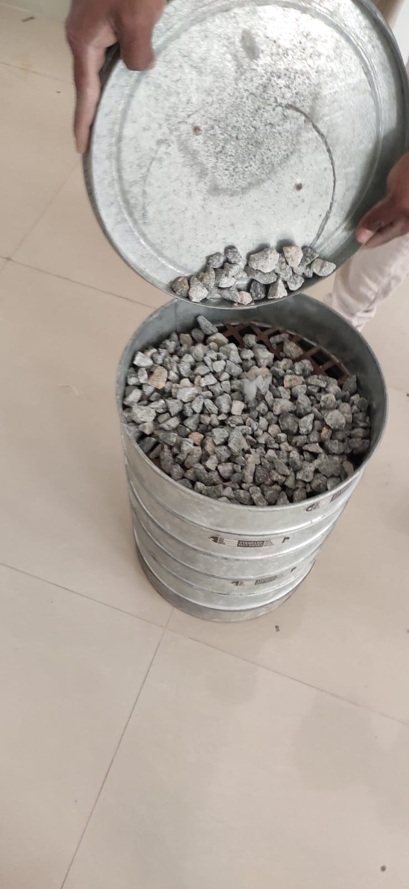
TESTS ON COARSE AGGREGATE
Fineness modulus of coarse aggregate.
Weight of aggregate = 3 kg.
Sl no | IS Sieve(mm,µ) | Weight Retained(g m) | Cumulative Weight Retained(gm) | Cumulative Retained(%) | Cumulative Passing(%)
1 | 80 | 0 | 0 | 0 | 100
2 | 40 | 0 | 0 | 0 | 100
3 | 20 | 91 | 3.03 | 3 | 97
4 | 16 | 1000 | 33.33 | 36 | 64
5 | 12.5 | 1286 | 42.86 | 78.86 | 21.14
6 | 10 | 441 | 14.7 | 93.56 | 6.44
7 | 6.3 | 102 | 3.4 | 96.96 | 3.04
8 | 4.75 | 60 | 2 | 98.96 | 1.04
 | Pan | 20 | 0.6 | 99.56 | 0.44
Fineness modulus of coarse aggregate= 7.1

Slide 20
Specific gravity test on coarse aggregate.
Sl no | weight (gm) | Trial 1 | Trial 2 | Trial 3
1 | Weight of empty Pycnometer(W1)
2 | Weight of empty Pycnometer + CA (W2)
3 | Weight of empty Pycnometer + CA + water (W3)
4 | Weight of empty Pycnometer + water (W4)
5 | Specific gravity

Slide 21
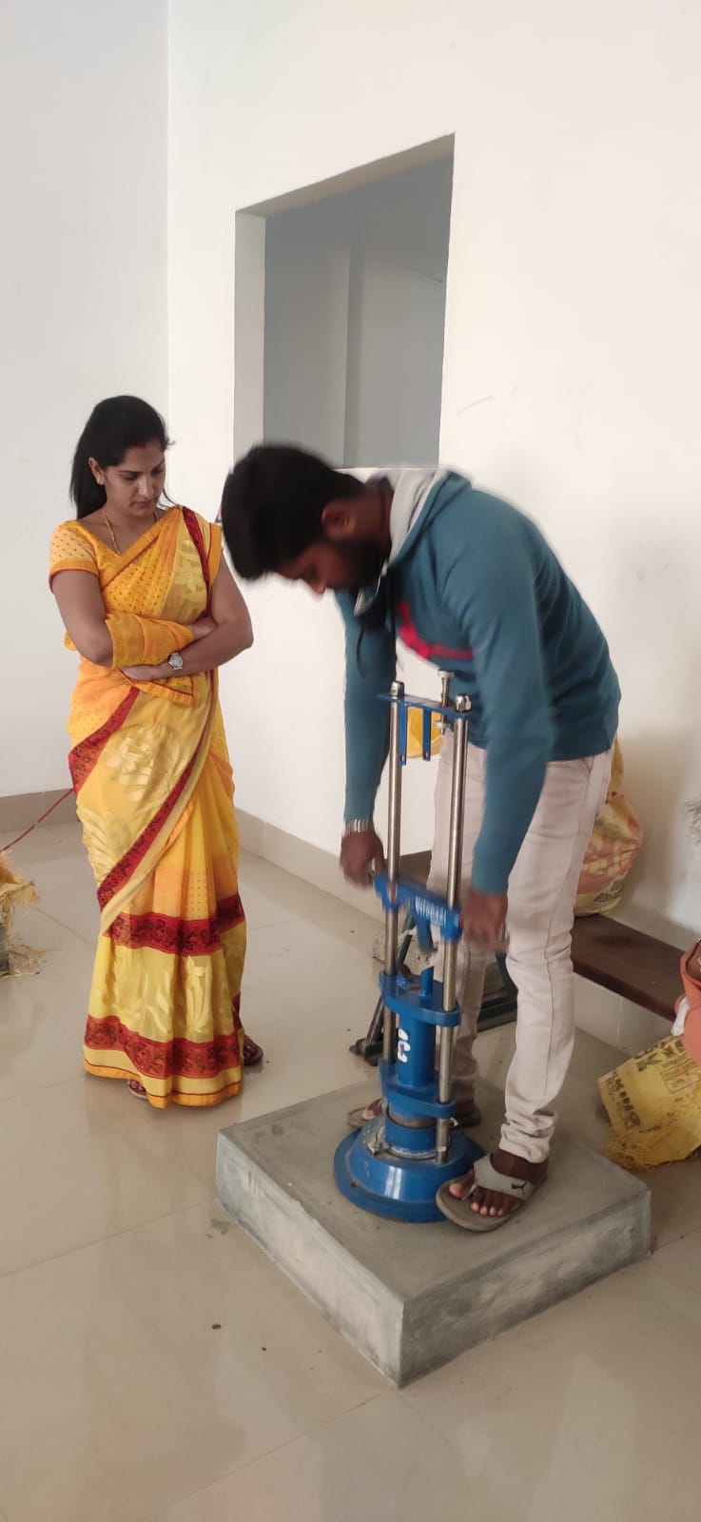
Impact test coarse aggregate.
Empty weight of cylinder = 1830gm
Weight of cylinder + aggregate = 2420gm
Weight of aggregate = 590gm
Trail no | No. of blows | Qty.of aggregate 10mm-12.5mm | Sample passing 2.36 sieve in gm | Percentage % Passing
01 | 25 | 590 | 82 | 13.2
Impact value = 13.8

Slide 22
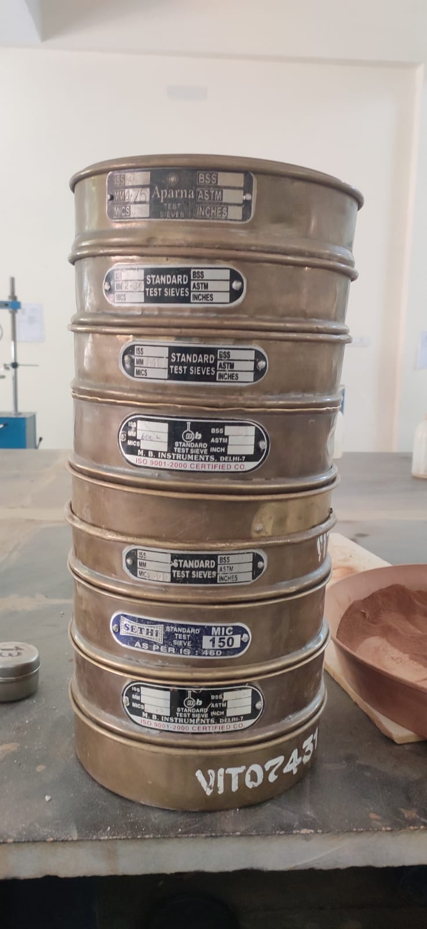
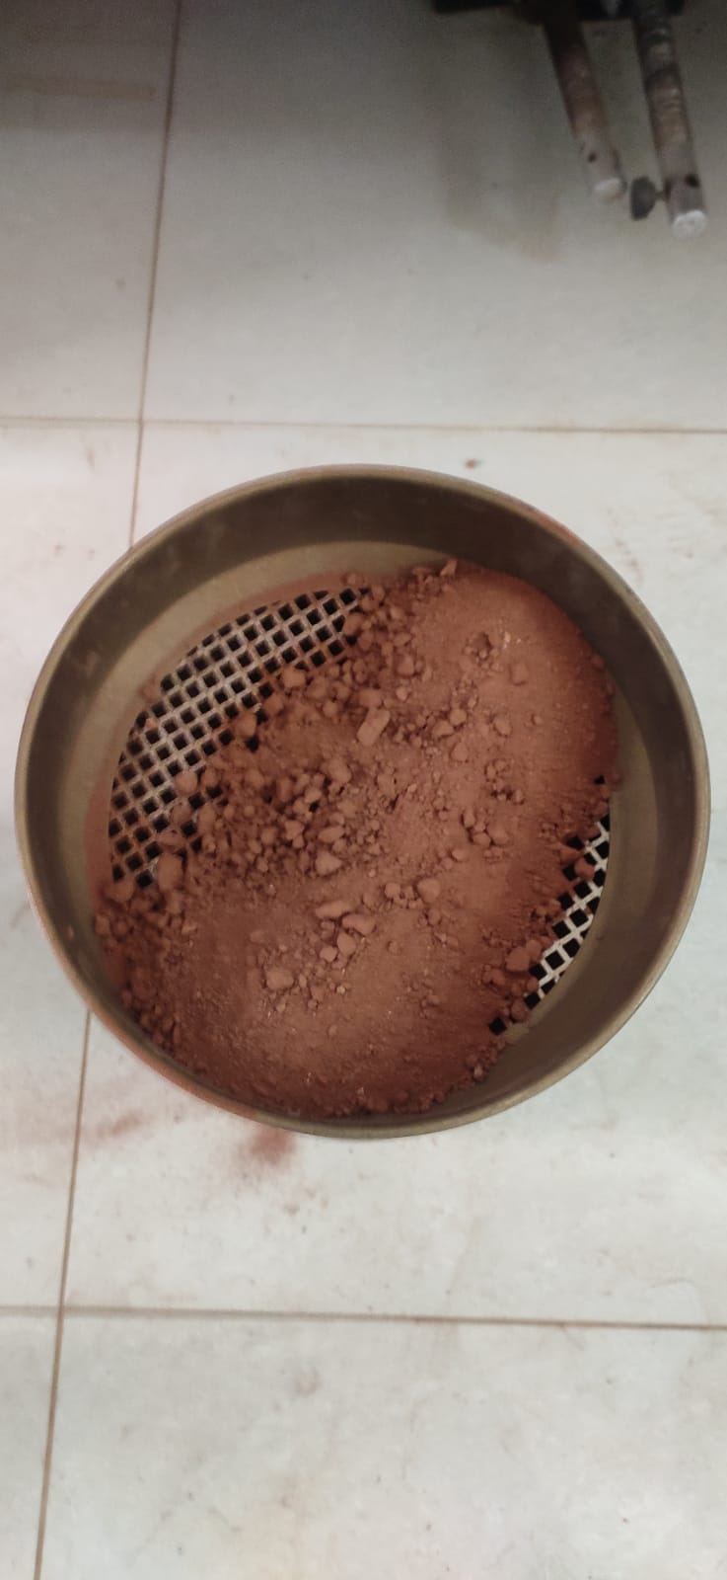
TESTS ON BRICK POWDER
Fineness modulus of brick powder.
Weight of aggregate = 1 kg
Sl no | IS Sieve(mm,µ) | Weight Retained(g m) | Cumulative Weight Retained(gm) | Cumulative Retained(%) | Cumulative Passing(%)
1 | 4.75 | 28 | 2.8 | 2.8 | 97.2
2 | 2.36 | 94 | 9.4 | 12.2 | 87.8
3 | 1.17 | 117 | 11.7 | 23.9 | 76.1
4 | 600 | 127 | 12.7 | 36.6 | 63.4
5 | 425 | 156 | 15.6 | 52.2 | 47.8
6 | 300 | 33 | 3.3 | 55.2 | 44.5
7 | 150 | 237 | 23.7 | 72.2 | 20.8
 | 75 | 149 | 14.9 | 94.1 | 5.9
 | Pan | 59 | 5.9 | 100 | 0
Fineness modulus ∑ = (cum retained%) / 100 = 2.4

Slide 23
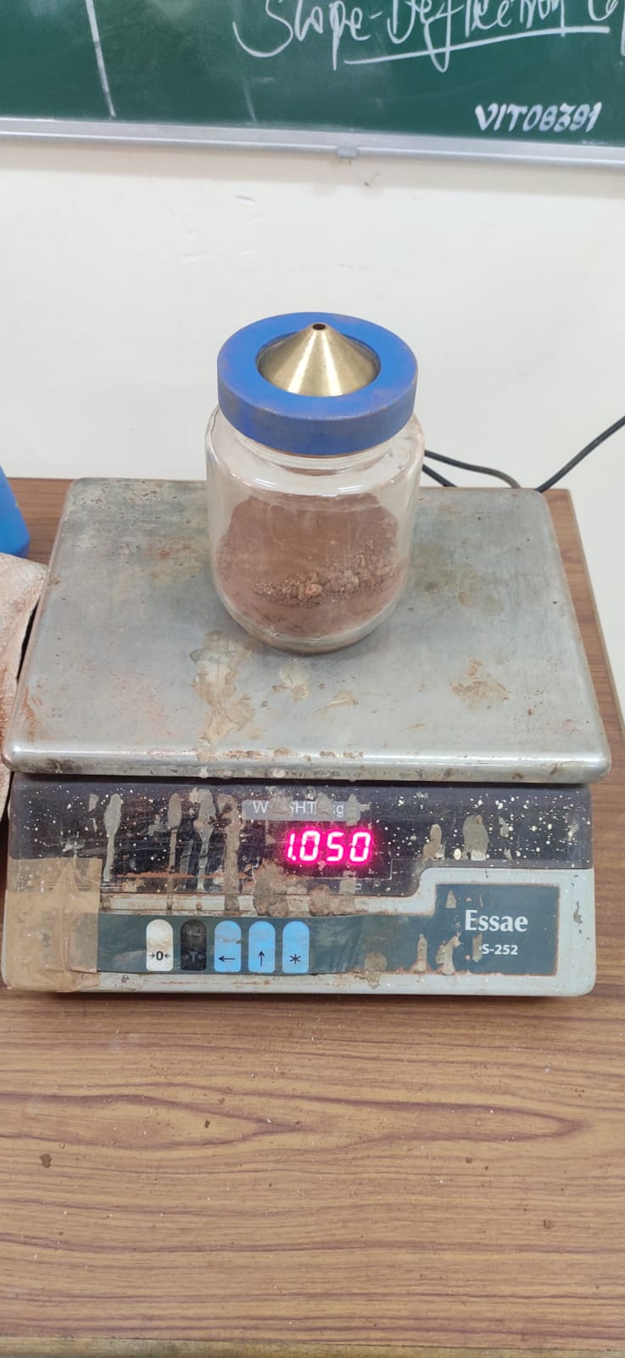
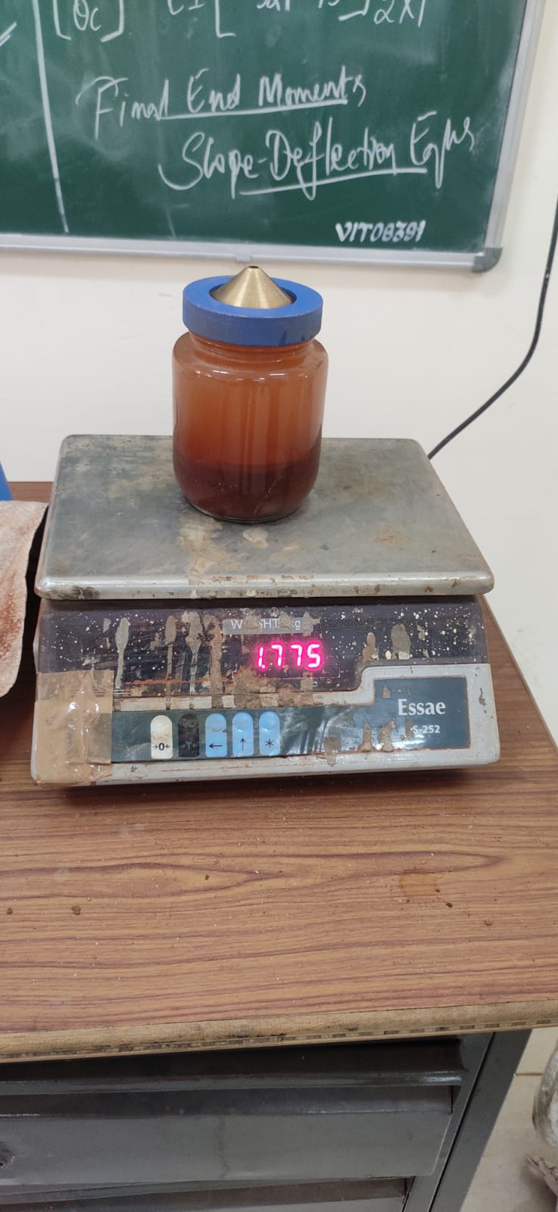
Specific gravity test on brick powder.
Specific gravity of fine aggregate =
Sl no | Weight (gm) | Trial 1 | Trial 2 | Trial 3
1 | Weight of empty Pycnometer(W1) | 659 | 659 | 659
2 | Weight of empty Pycnometer + BP (W2) | 1050 | 1055 | 1041
3 | Weight of empty Pycnometer + BP + water (W3) | 1775 | 1781 | 1780
4 | Weight of empty Pycnometer + water (W4) | 1541 | 1541 | 1541
5 | Specific gravity | 2.64 | 2.53 | 2.67
W2-W1
= 2.61
(W2-W1) – (W3-W4)

Slide 24
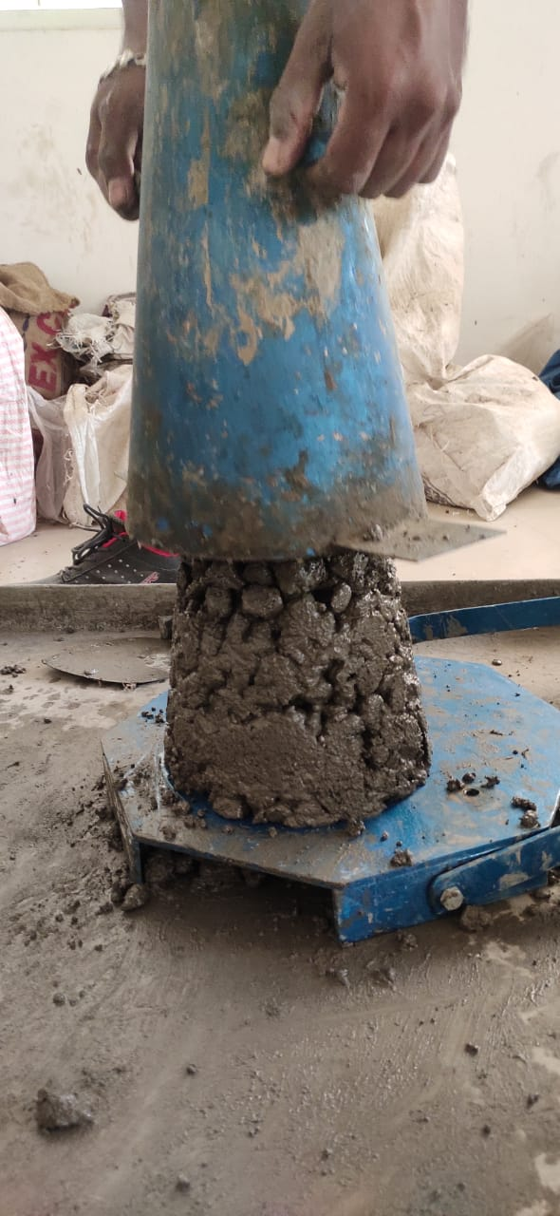
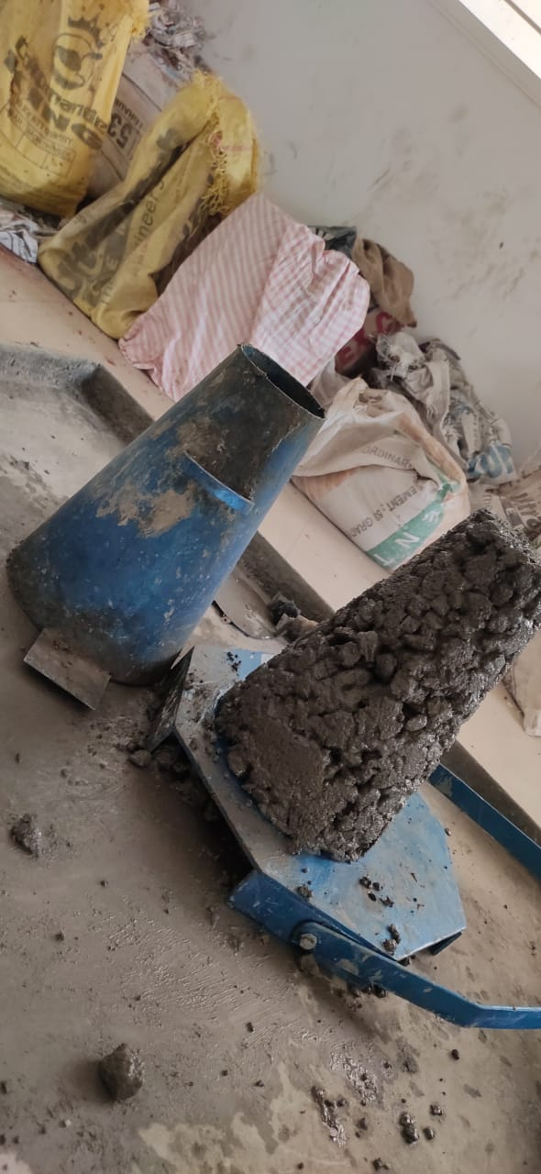
SLUMP TEST
SLUMP TEST
50mm
with and without Brick powder.

Slide 25
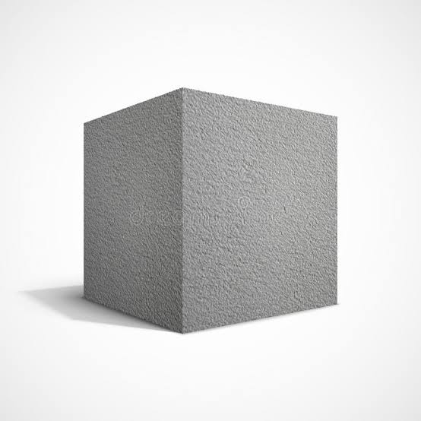
CAST & TEST
3 number of cubes, are cast without brick powder and 9 number of cubes are cast with brick powder.
9 number of cubes are cast with 15%,25%&30% as partial replacement of fine aggregate using brick powder
The cast specimens are cured, after curing the specimens are tested for 7days, 14days and 28 days.
Cube 150x150x150mm

Slide 26
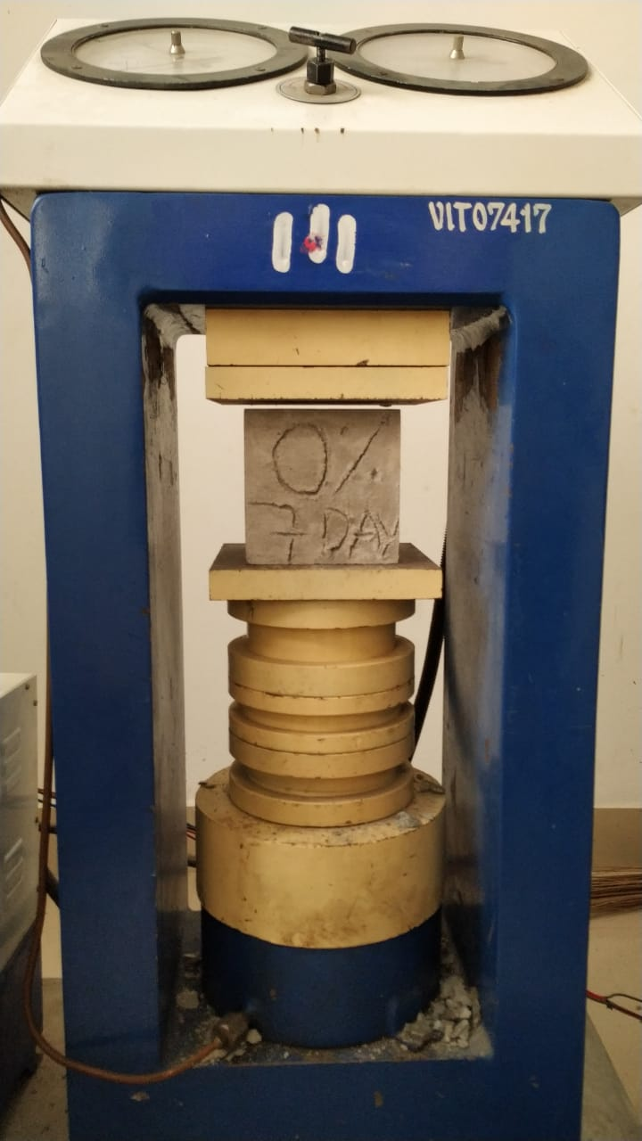
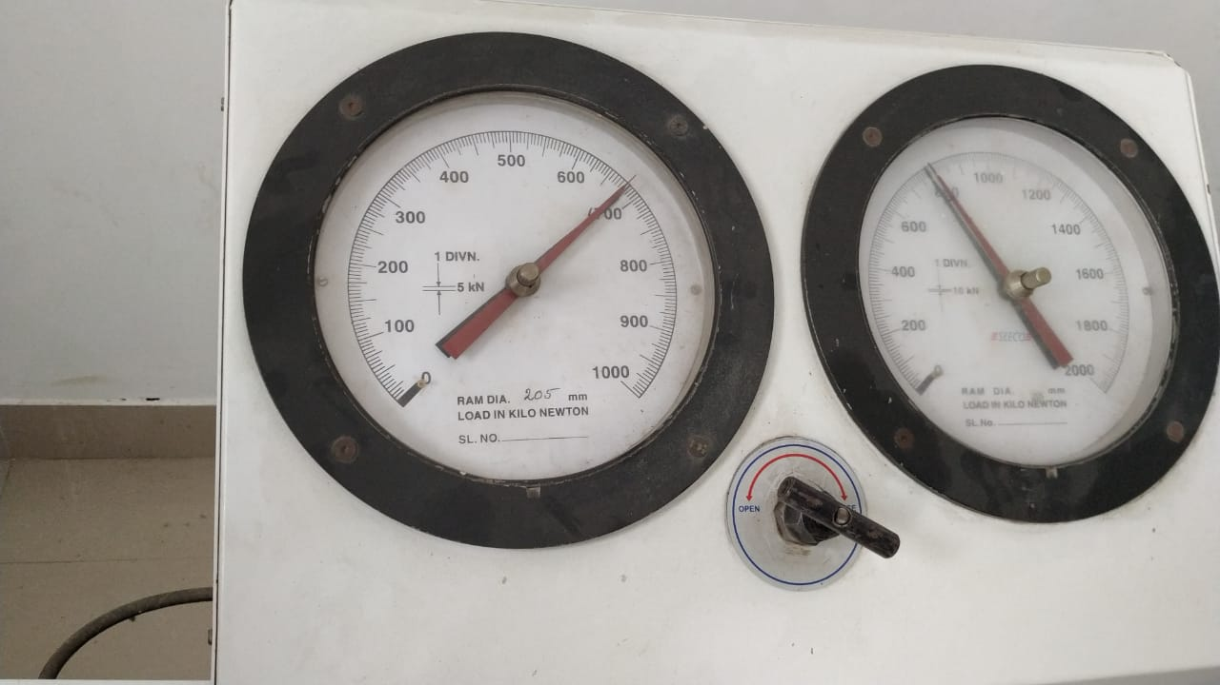
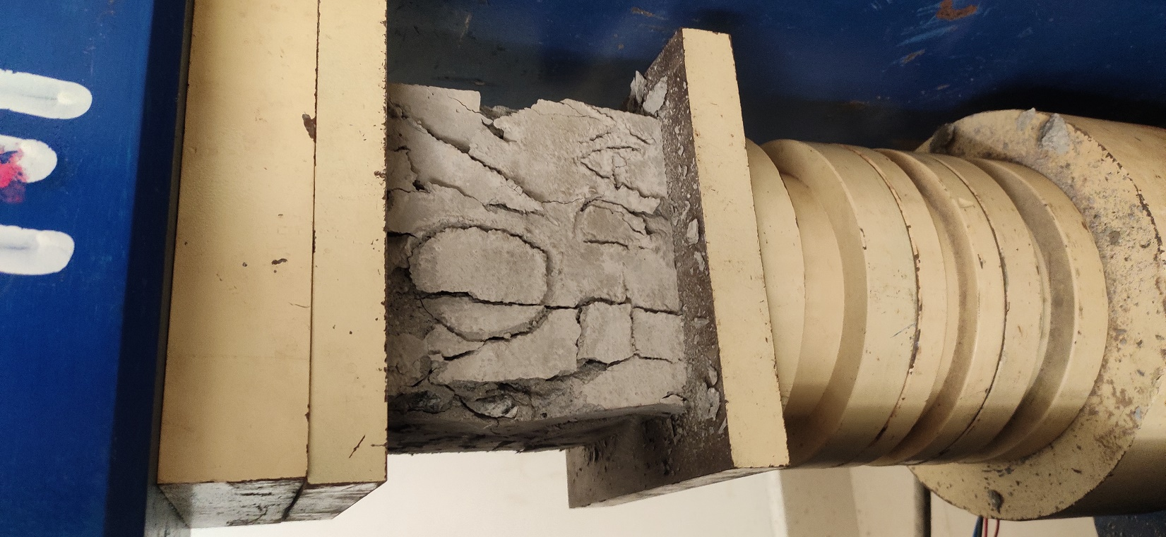
COMPRESSIVE STRENGTH TEST
The compressive strength test is carried on cube size of 150×150×150mm. 9 number of cubes will be tested with brick powder of 15%, 25% and 30% and 3 cubes without brick powder for 7days, 14days and 28 days.
7 DAYS CURING
Cube without brick powder (0%):

Slide 27
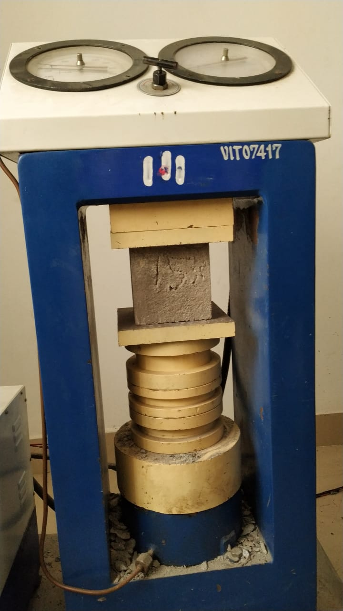
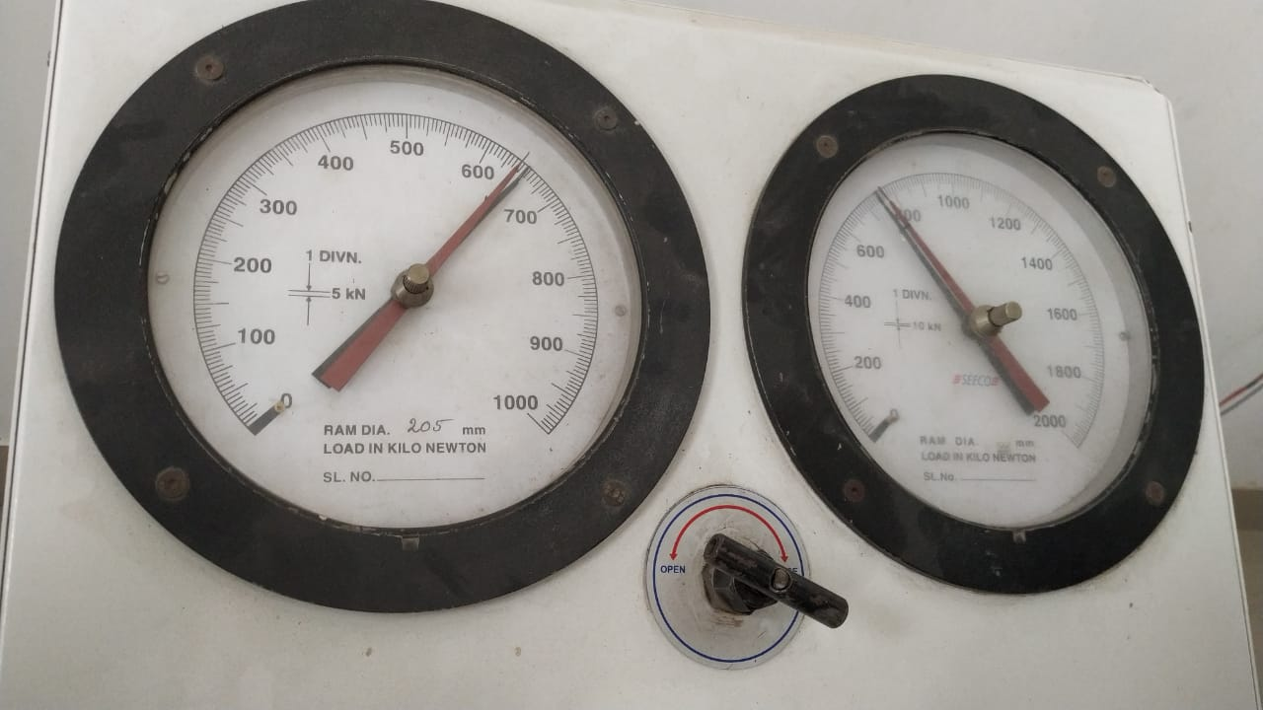
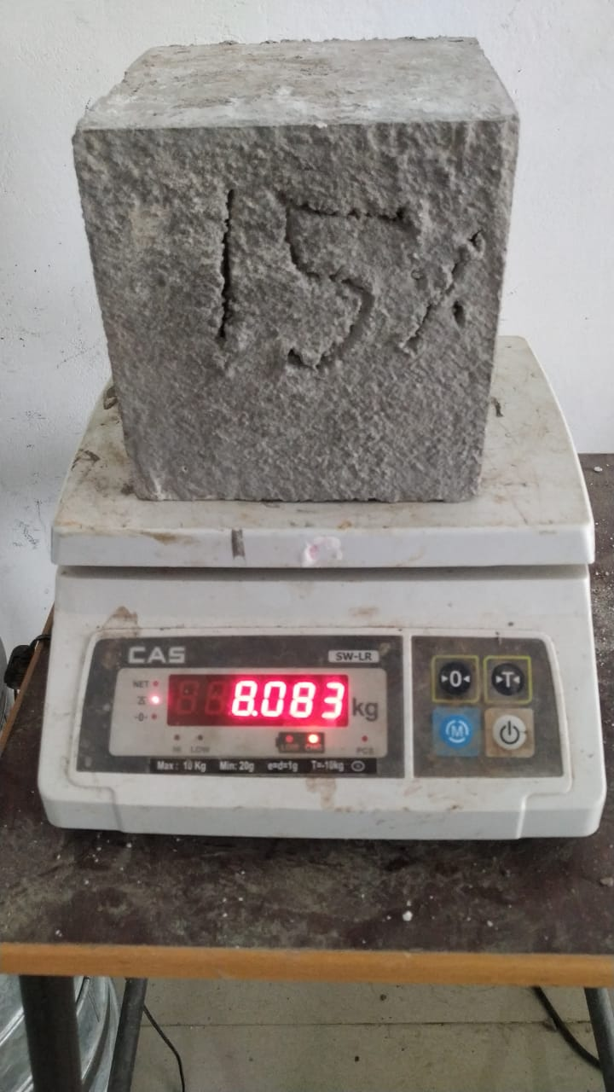
Cube with brick powder (15%): Here fine aggregate has been replaced about 15% of total weight of sand.

Slide 28
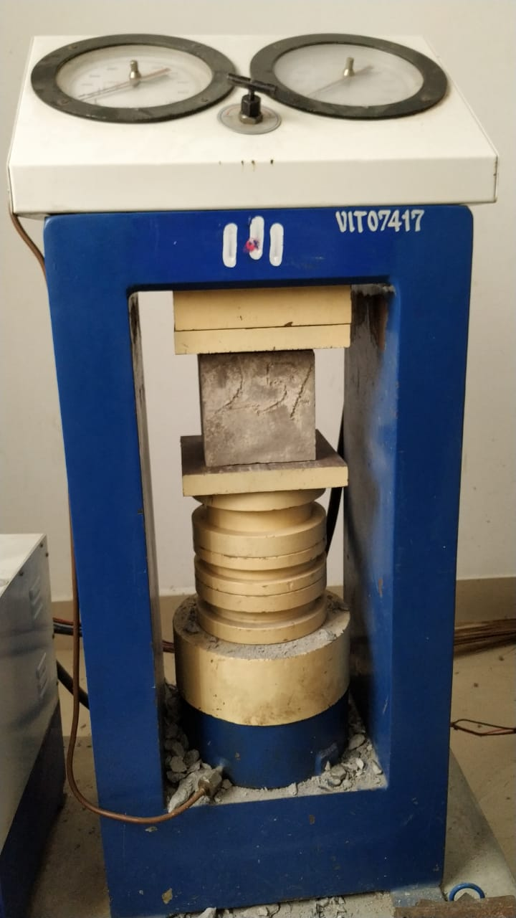
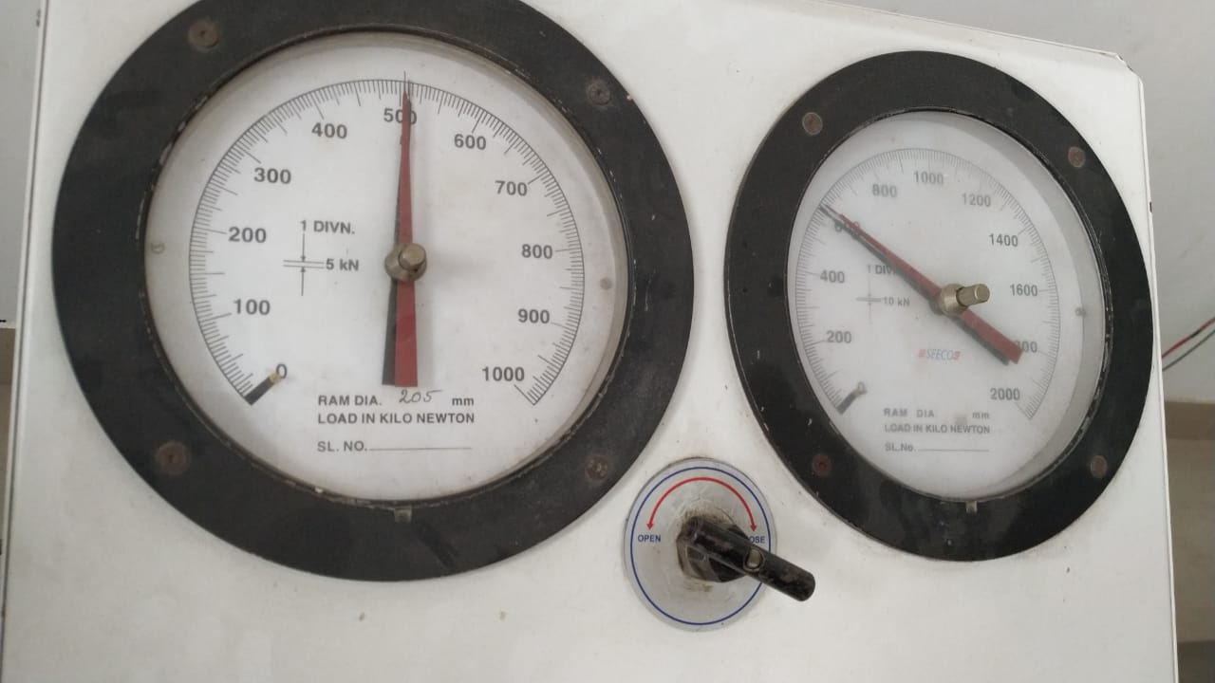
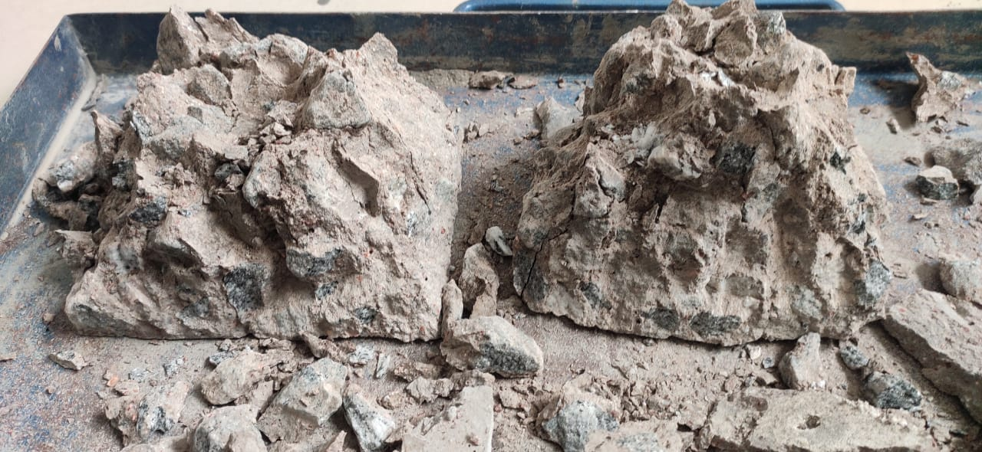
Cube with brick powder (25%): Here fine aggregate has been replaced about 15% of total weight of sand.

Slide 29
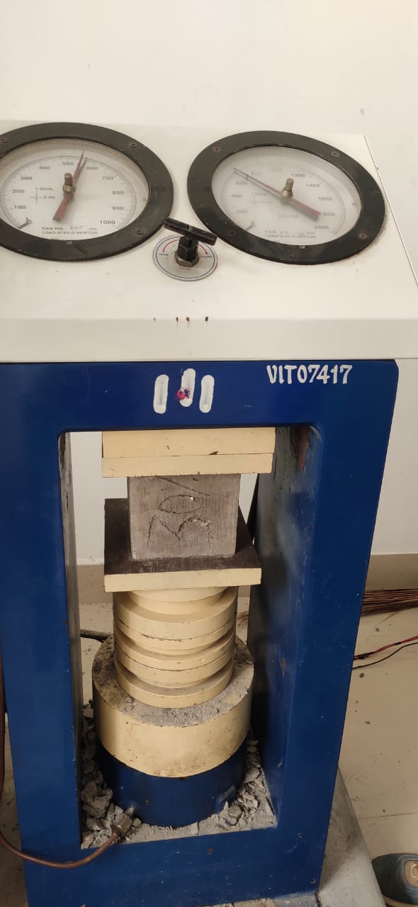
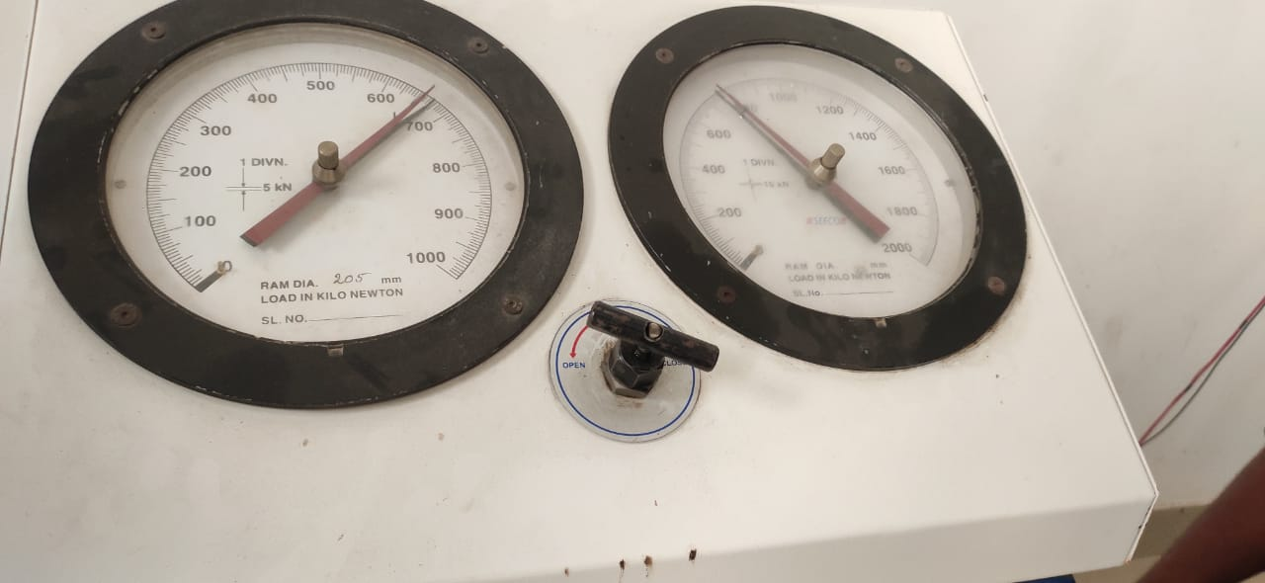
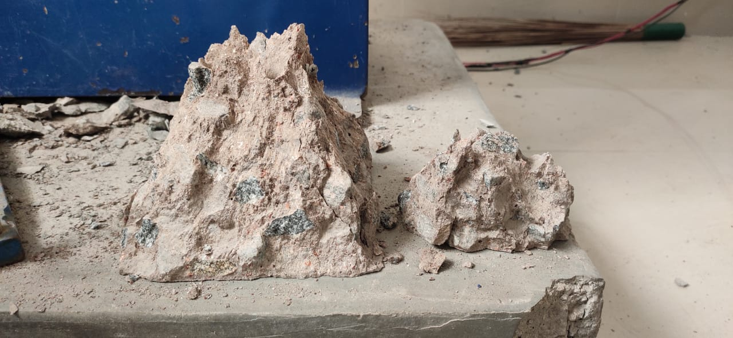
Cube with brick powder (30%): Here fine aggregate has been replaced about 15% of total weight of sand.

Slide 30
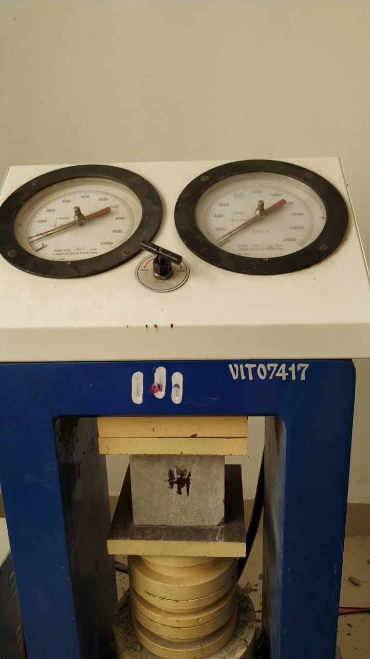
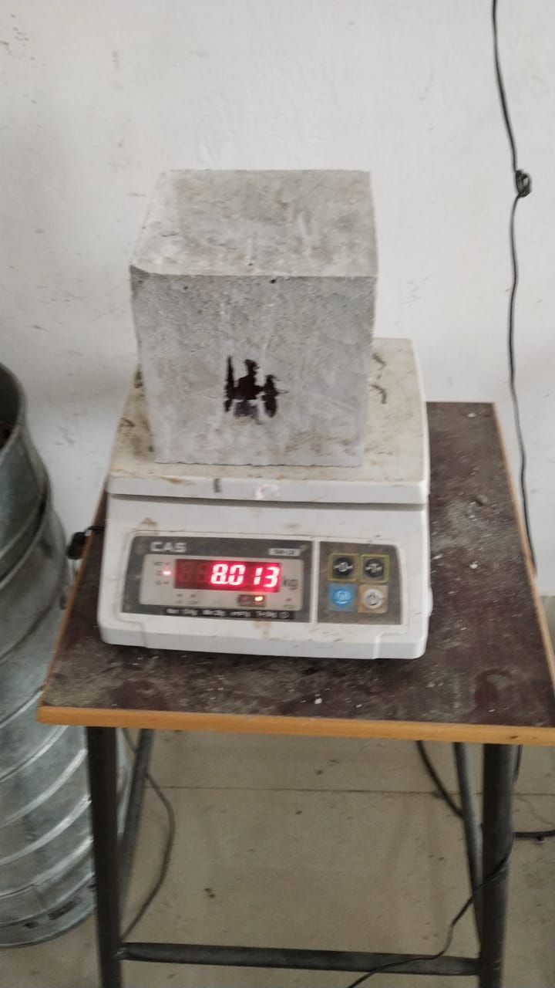
14 DAYS CURING:
Cube without brick powder (0%):

Slide 31
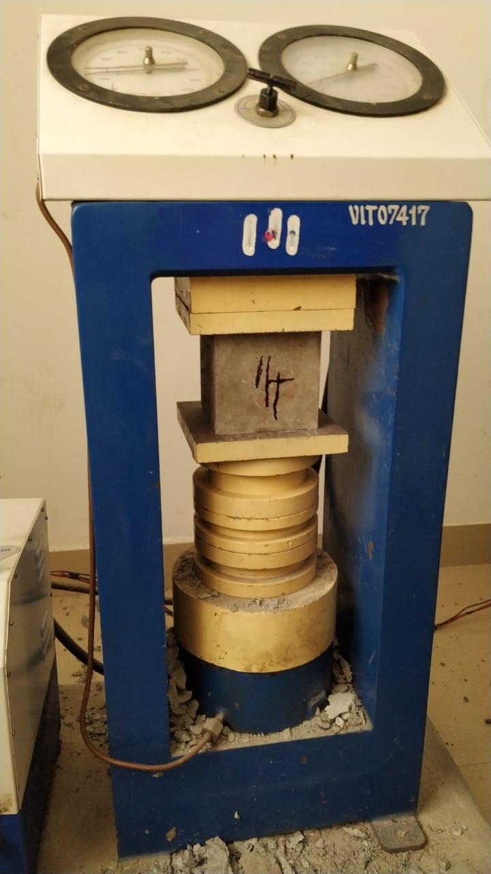
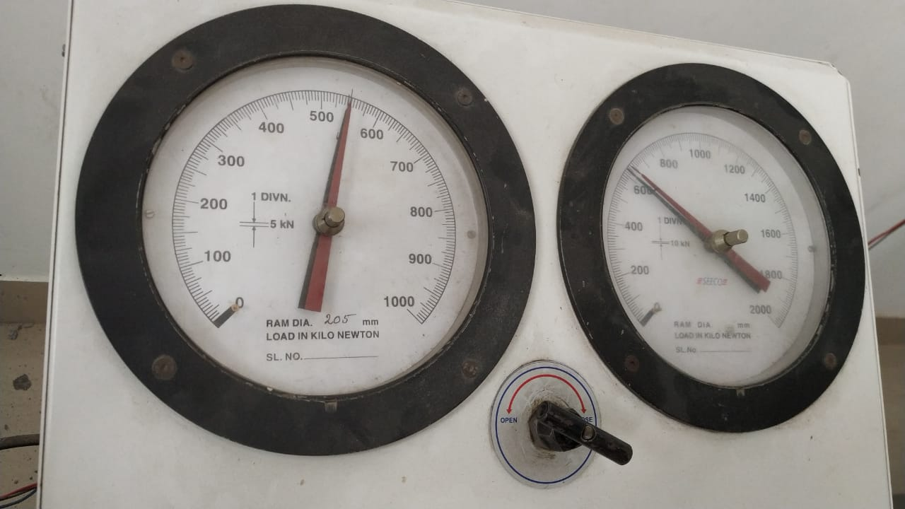
Cube with brick powder (15%):

Slide 32
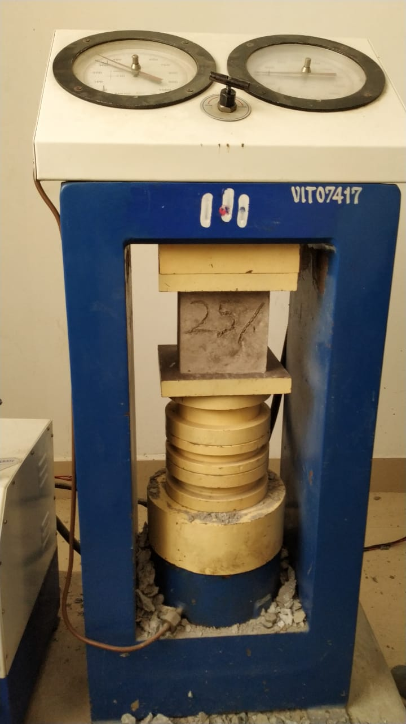
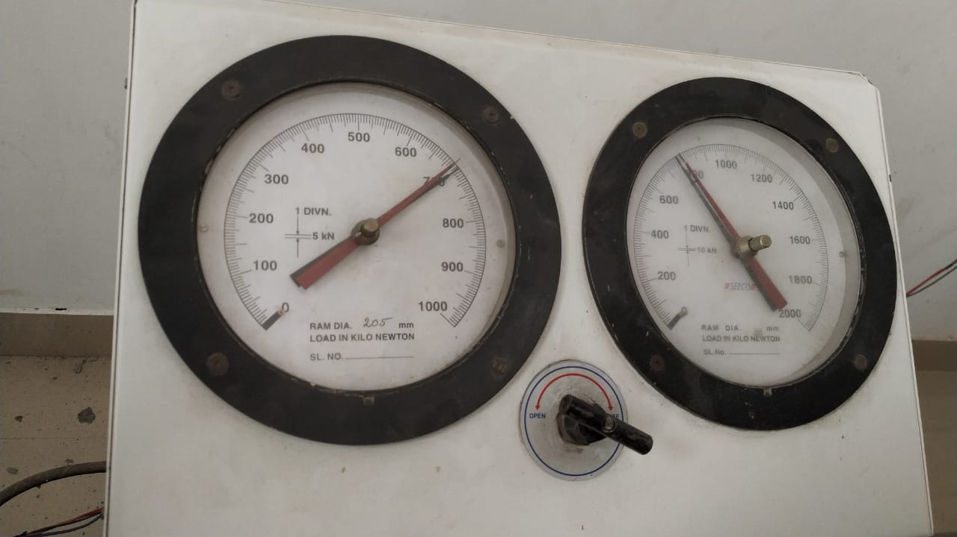
Cube with brick powder (25%):

Slide 33
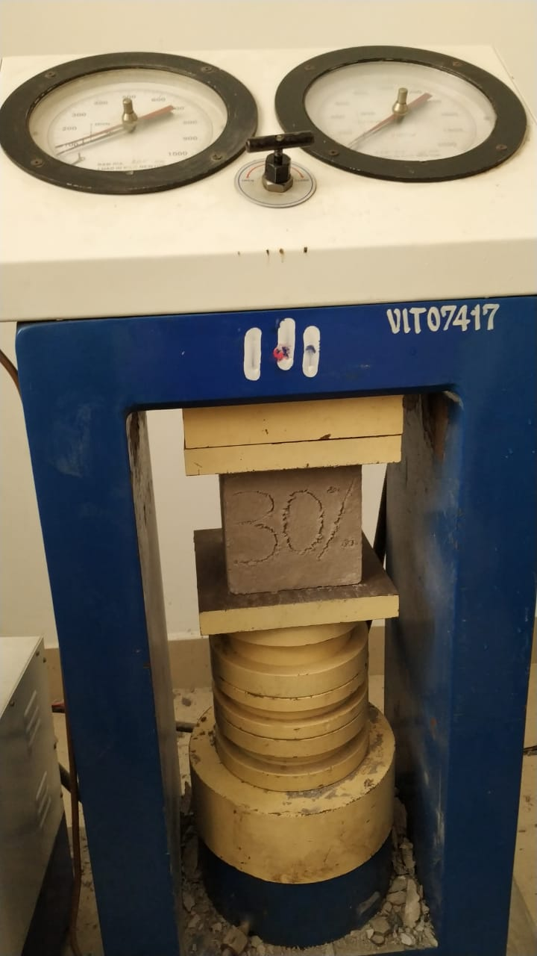
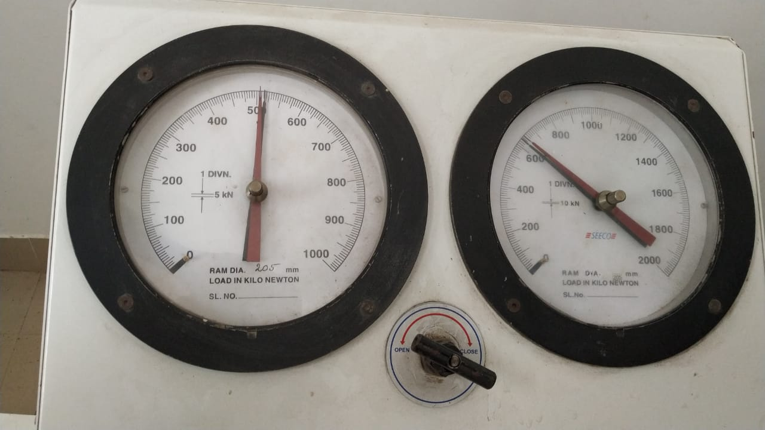
Cube with brick powder (30%):

Slide 34
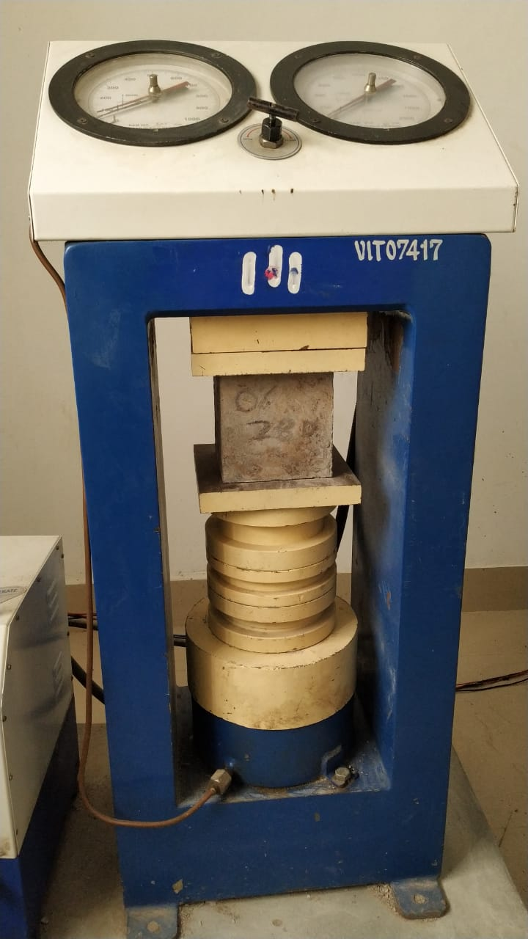
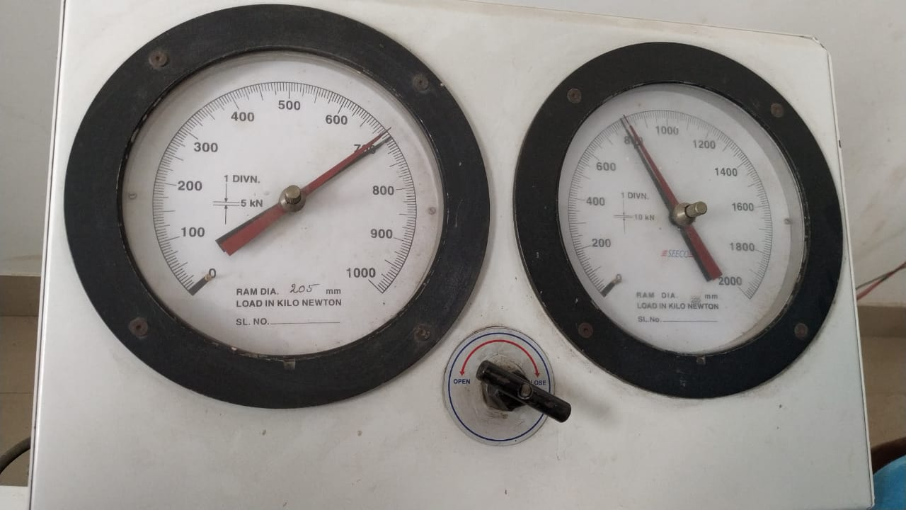
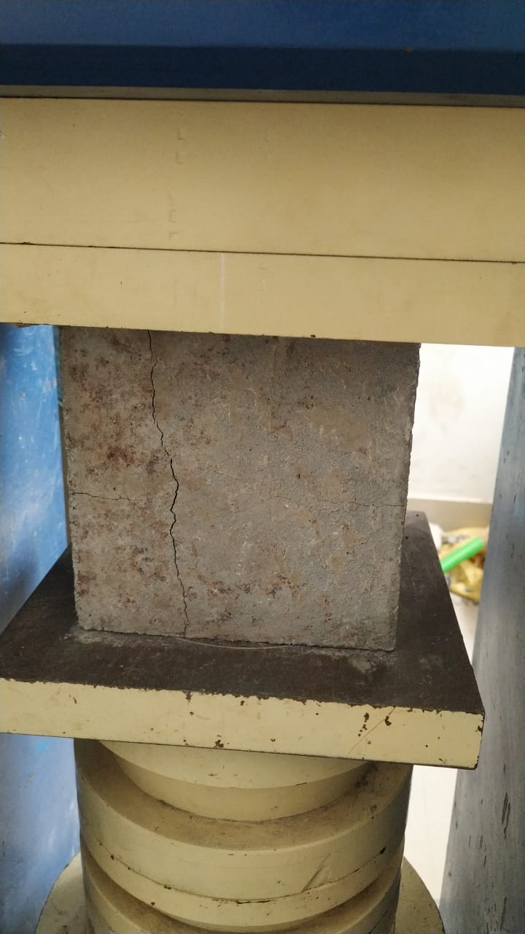
28 DAYS CURING
Cube without brick powder (0%):

Slide 35
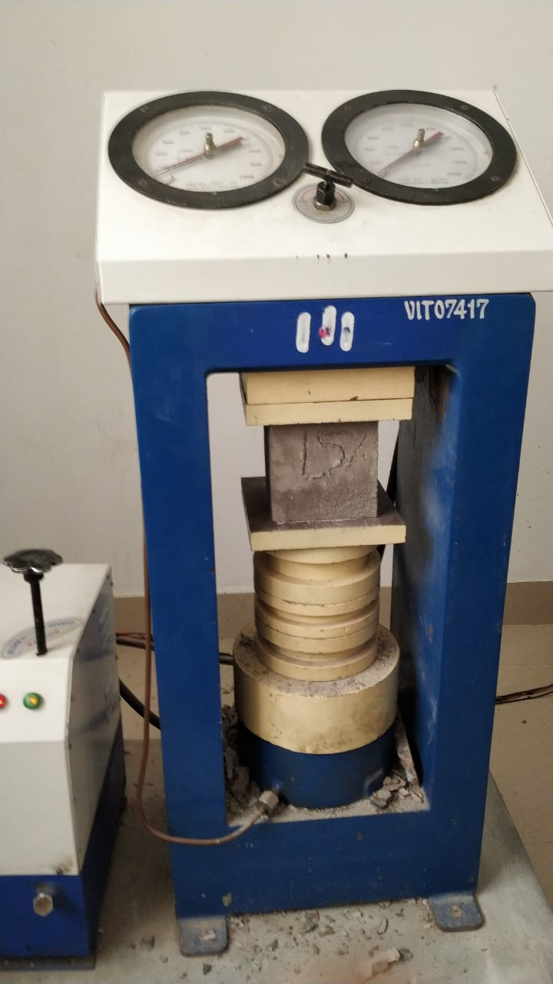
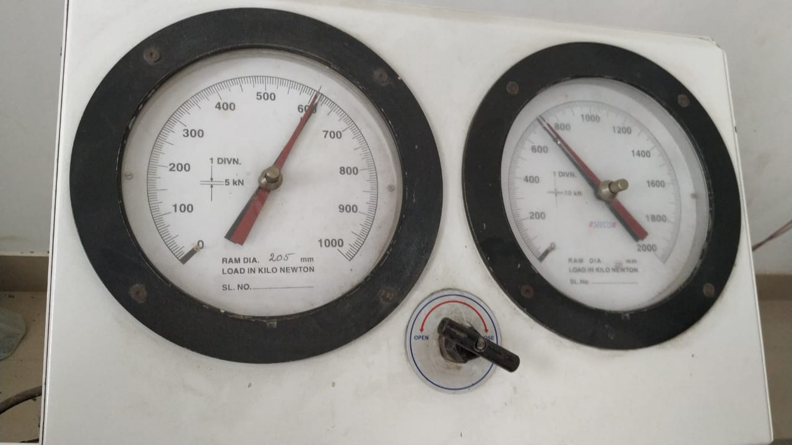
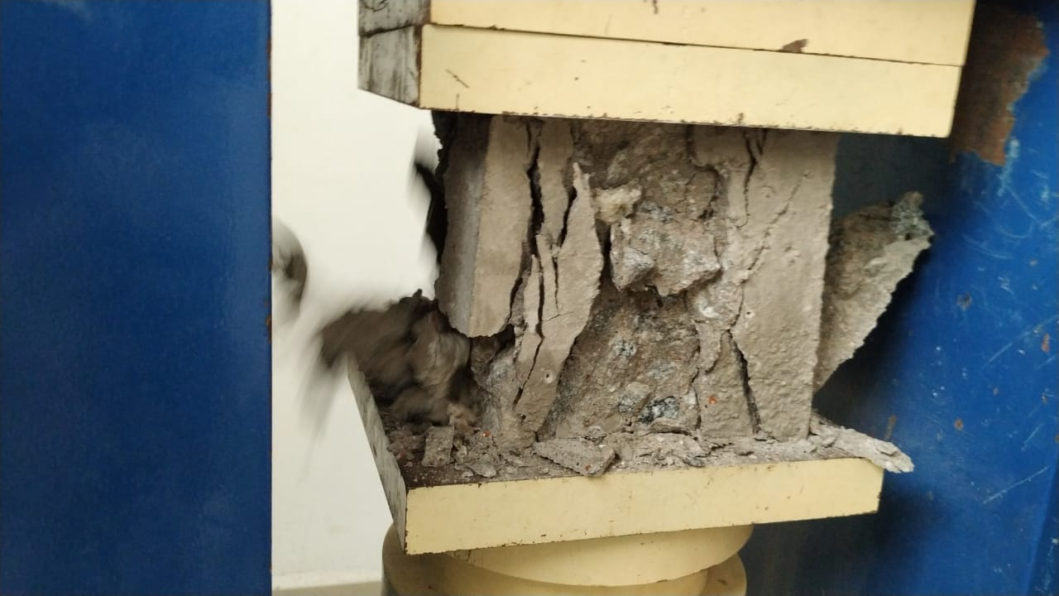
Cube with brick powder (15%):

Slide 36
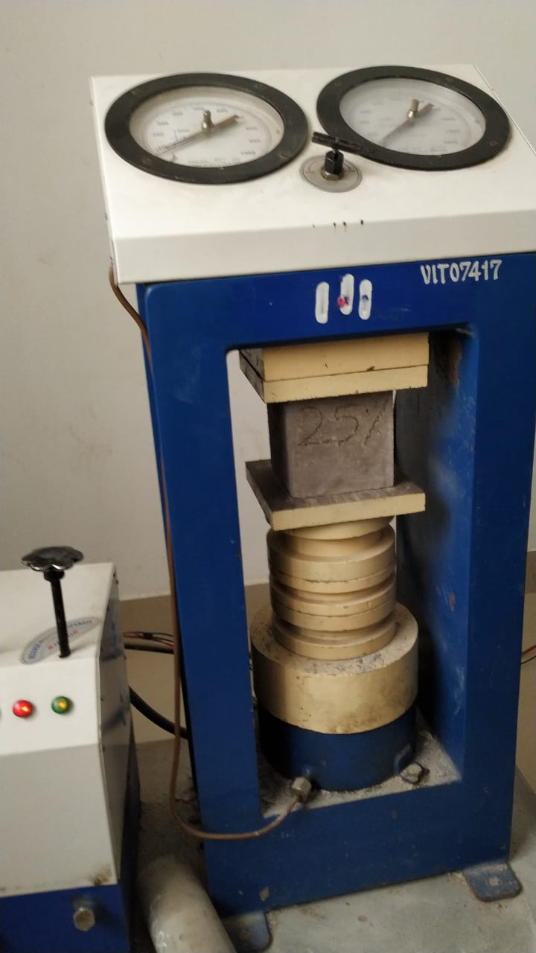
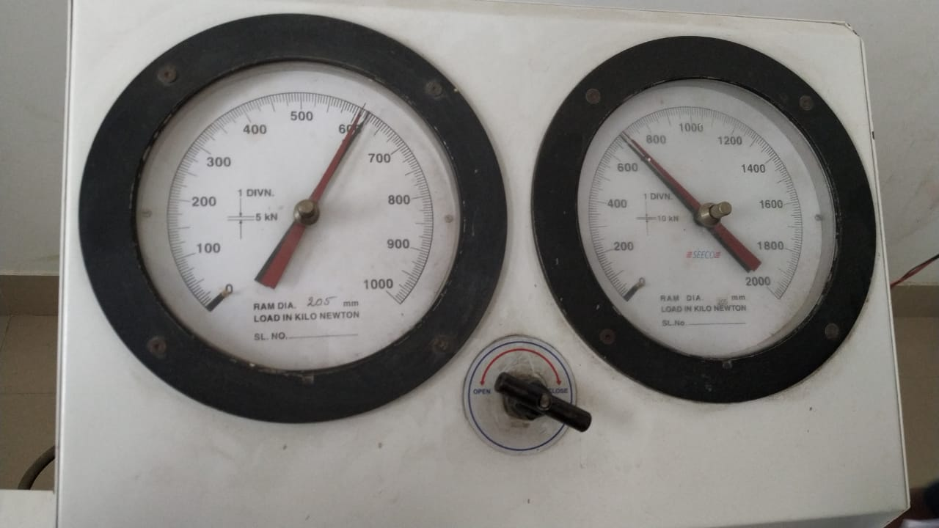
Cube with brick powder (25%):

Slide 37


Cube with brick powder (25%):

Slide 38
COMPRESSION TEST
Sl no | Mark on cube or cube designation | Date of casting | Date of testing | Area (mm²) | Load(P) KN | Compressive strength(N/mm²) (P/A)
01 | 7 DAYS CURING
 | 0% | 29/03/22 | 07/04/22 | 22500 | 810 | 36
 | 15% | 08/04/22 | 18/04/22 | 22500 | 730 | 32.44
 | 25% | 08/04/22 | 18/04/22 | 22500 | 570 | 25.33
 | 30% | 08/04/22 | 18/04/22 | 22500 | 760 | 33.77
02 | 14 DAYS CURING
 | 0% | 29/03/22 | 17/04/22 | 22500 | 920 | 40.88
 | 15% | 08/04/22 | 26/04/22 | 22500 | 620 | 27.55
 | 25% | 08/04/22 | 26/04/22 | 22500 | 760 | 33.77
 | 30% | 08/04/22 | 26/04/22 | 22500 | 630 | 28
03 | 28 DAYS CURING
 | 0% | 29/03/22 | 06/05/22 | 22500 | 780 | 34.66
 | 15% | 08/04/22 | 11/05/22 | 22500 | 700 | 31.11
 | 25% | 08/04/22 | 11/05/22 | 22500 | 700 | 31.11
 | 30% | 08/04/22 | 11/05/22 | 22500 | 890 | 39.55

Slide 39
FLEXURAL TENSILE TEST
Sl no | Mark on beam / beam designation | Date of casting | Date of testing | Load(P) | Flexural strength(N/mm²)
 | 10
 | 11
 | 10
Flexural strength = PL / bd² N/mm²

Slide 40
CONCLUSION.
Conclusion will be drawn from the test results obtained.

Slide 41
SCHEDULE OF LABORATORY WORKS.
Week – 1 and 2.
Characterization of materials and selection of materials by trial mix.
Week – 3.
Design of M20 concrete mix for 50mm slump.
Week – 4&5.
Casting of cubes, cylinder and beams.
Curing.
Week – 6.
Testing cubes, for 7days, 14 days & 28days and analysis of results.

Slide 42
REFERENCES
K. Muthusamy, A. M. A. Budiea, S. M. Syed Mohsin et al., Properties of fly ash cement brick containing palm oil clinker as fine aggregate replacement, Materials Today: Proceedings, https://doi.org/10.1016/j.matpr.2020.07.260
S. Rahul D, S. Vikas Reddy, T. N et al., Influence of brick waste and brick waste fines as fine aggregate on the properties of paver blocks – Preliminary investigation, Proceedings, https://doi.org/10.1016/j.matpr.2020.09.310
JuntaoDang, sze Daipang et al., Durability and micro structural properties of concrete with recycled brick as fine aggregate – Preliminary investigation, Proceedings, https://doi.org/10.1016/j.conbuildmat.2020.120032
Imane Rainia, Raouf Jabrane, et al., Evaluation of mortar properties by combining concrete and brick wastes as fine aggregate – Preliminary investigation, Proceedings, https://doi.org/10.1016/j.cscm.2020.e00434
Arivalagan. S Et al., Feasible and Experimental Study on Partial Replacement of Fine Aggregate using Construction Debris http://dx.doi.org/10.20902/IJCTR.2019.130206

Slide 43
Sai Samanth, and A. Prakhar, “Study of strength properties of concrete with construction debris as aggregates”, International Journal of Engineering Research in Mechanical and Civil Engineering, Vol. 1(5), pp 42-45, 2016
Diniya David, et al., Partial Replacement of Fine Aggregate with Crushed Clay Brick in Cellular Concrete. International Journal of Research in Engineering and Technology. DOI:10.15680/IJIRSET.2017.0605161
A. Shayan and A. Xu, “Value added utilization of waste glass in concrete”, Cement and Concrete Research, vol-44, pp.81-89, Jan.2004.
Shriharsha, Murthy S.N. Alternative building materials using fine ground granulated blast furnace slag and fine demolition debris. International Journal of Renewable Energy and Environmental Engineering. 2(2), 2014, pp 86-88.
IS 383-1970: Indian Standard specifications for coarse and fine aggregate. Bureau of Indian standards.
IS 456-2000: Code of Practice for Plain and Reinforced Concrete. Bureau of Indian standards.
IS 10262-2209: Recommended guidelines for Mix Concrete. Bureau of Indian standards.
IS 2386-1963 Methods of test for aggregate for concrete. Bureau of Indian standards.

Slide 44
THANK YOU

